Slide 1

Study Skills

Slide 2

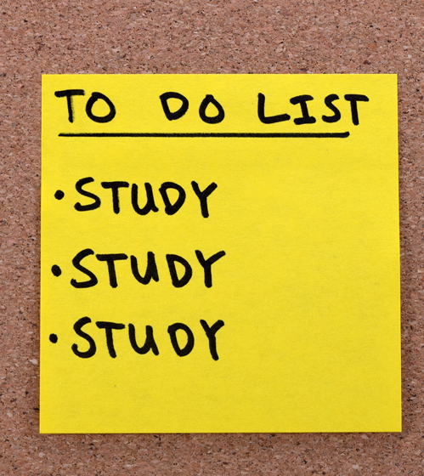
studying for exams

Slide 3

Initial Plan
Look at your syllabi and create a study calendar including your finals.
Be sure to consider the following:
  Time of day you are most focused
  Location – Distraction free environments
  Whether having a study partner is right for you
3

Slide 4
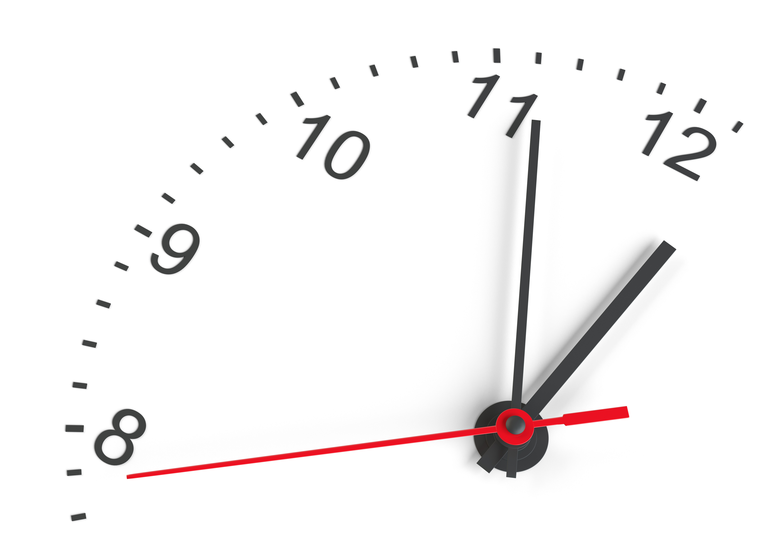
Timing
Figure out when you are most productive and best able to focus.
This may be first thing in the morning, late at night, after a meal, etc.
Plan your study/work sessions during your most productive times.
4

Slide 5

Find a Good place
Picking a good place to study is crucial.
First, identify what distracts you. Find an environment that limits these distractions.
  Examples: Library, Dorm Lounge, outdoors by the pond, etc.
Get out of the habit of studying in bed.
  Train yourself to associate that being in your bed means "sleep" and the chair or table means "read". (This will also help if you have trouble sleeping.)
5

Slide 6
Study partners (body doubling)
Studying or working alongside others can be motivating.
Pick your study partners carefully.
Try to select those with good study habits and make an effort to focus on the work - save chatting for break time!
6

Slide 7

Study Rituals
  Book your favorite study room at the library
  Get your favorite drink or snack to have while you study
  Wear a comfy outfit to study in
  Create a playlist to listen to while you study (if music isn't distracting)
  Use your fun pens and highlighters to make notes
  Plan to call or meet up with a friend when you're done studying for the day
  Treat yourself when you hit your study goal for the day (watch a movie, get a sweet treat, etc)
7

Slide 8

Six strategies for effective learning
All of these strategies have supporting evidence from cognitive psychology:
Spaced Practice
Retrieval Practice
Elaboration
Interleaving
Concrete Examples
Dual Coding THE LEARNING SCIENTISTS
8

Slide 9
Spaced Practice

Slide 10
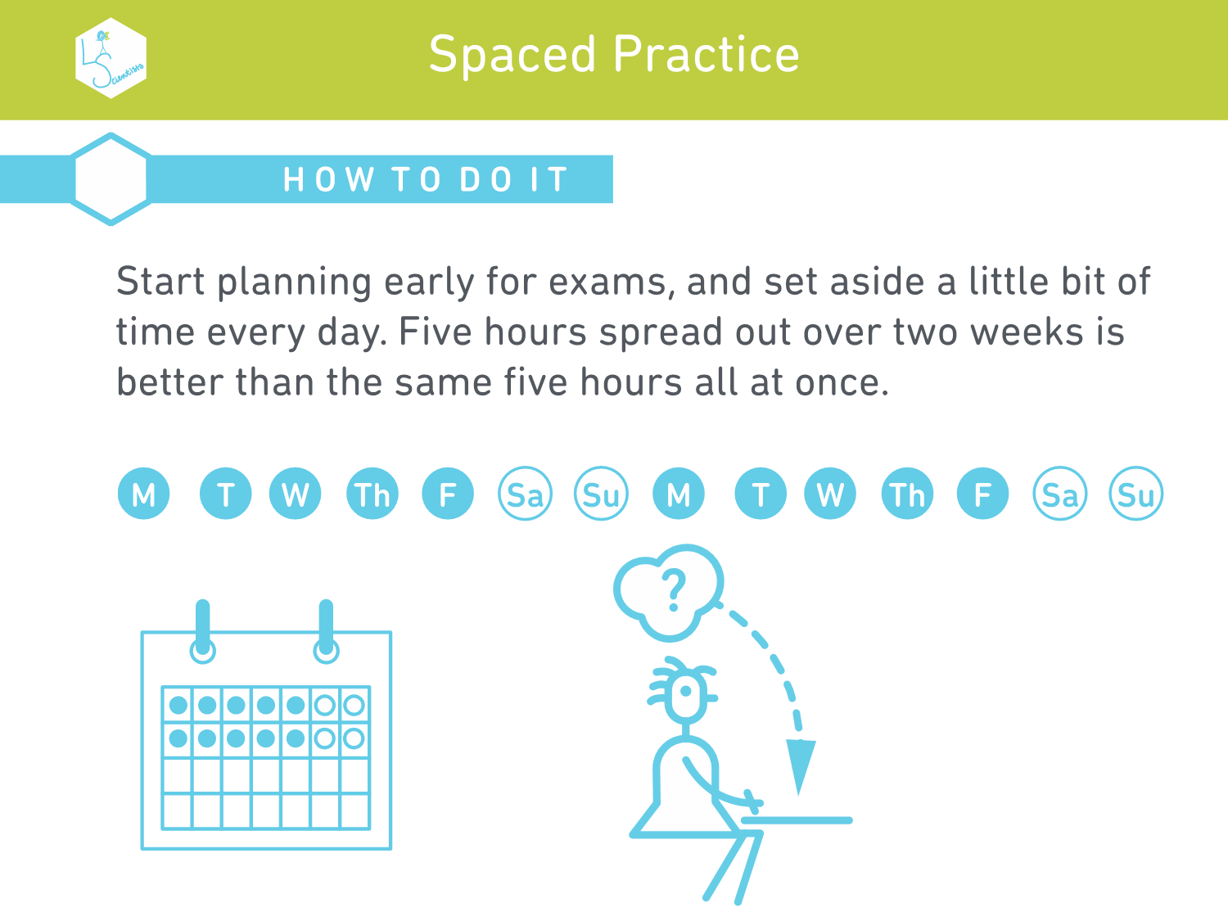
10

Slide 11
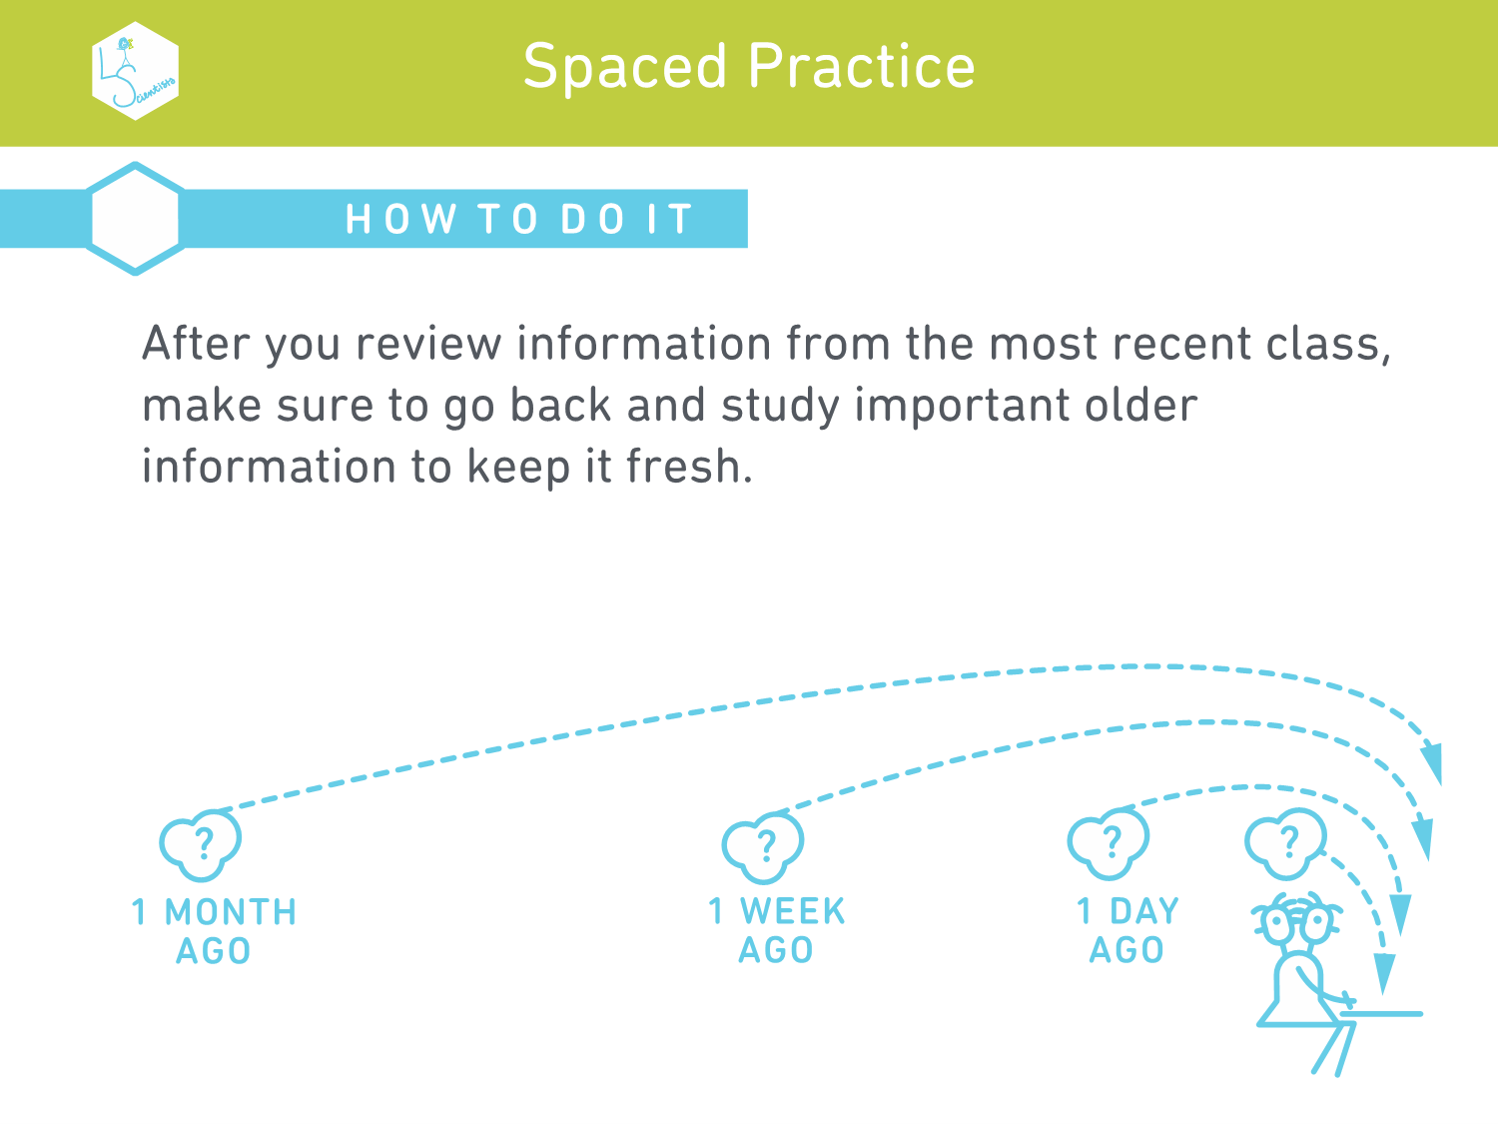

Slide 12
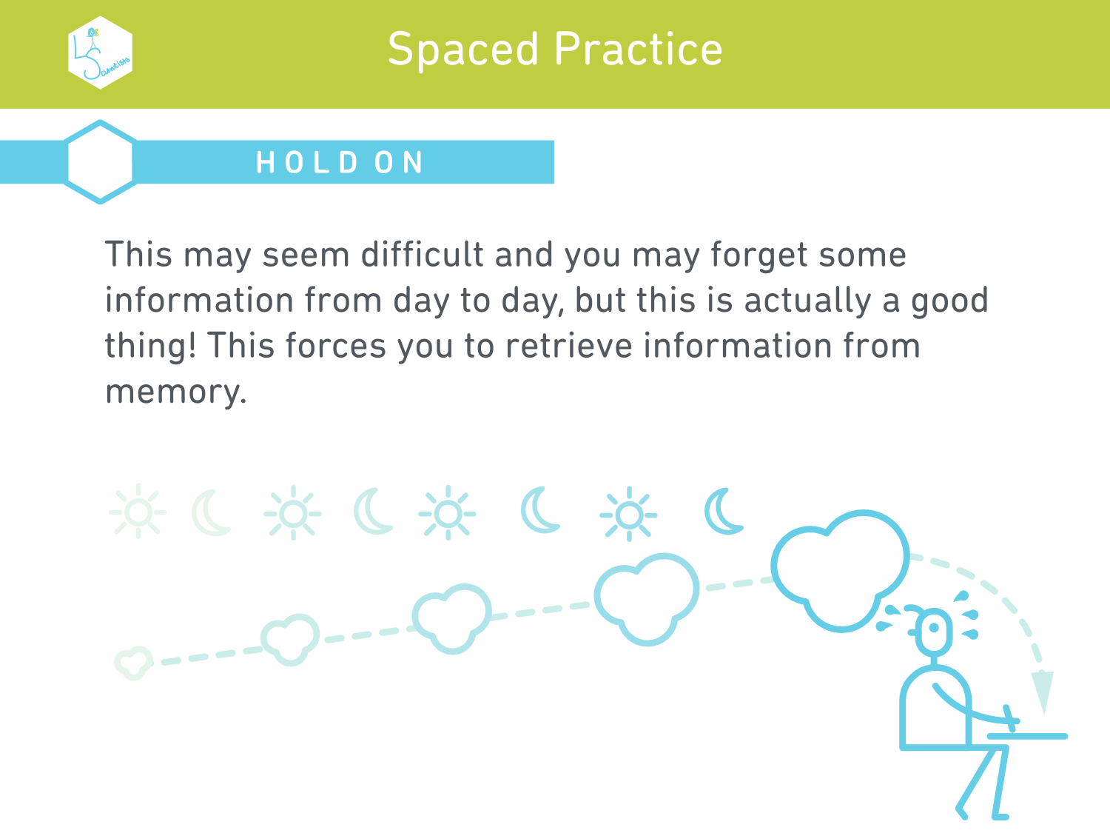

Slide 13
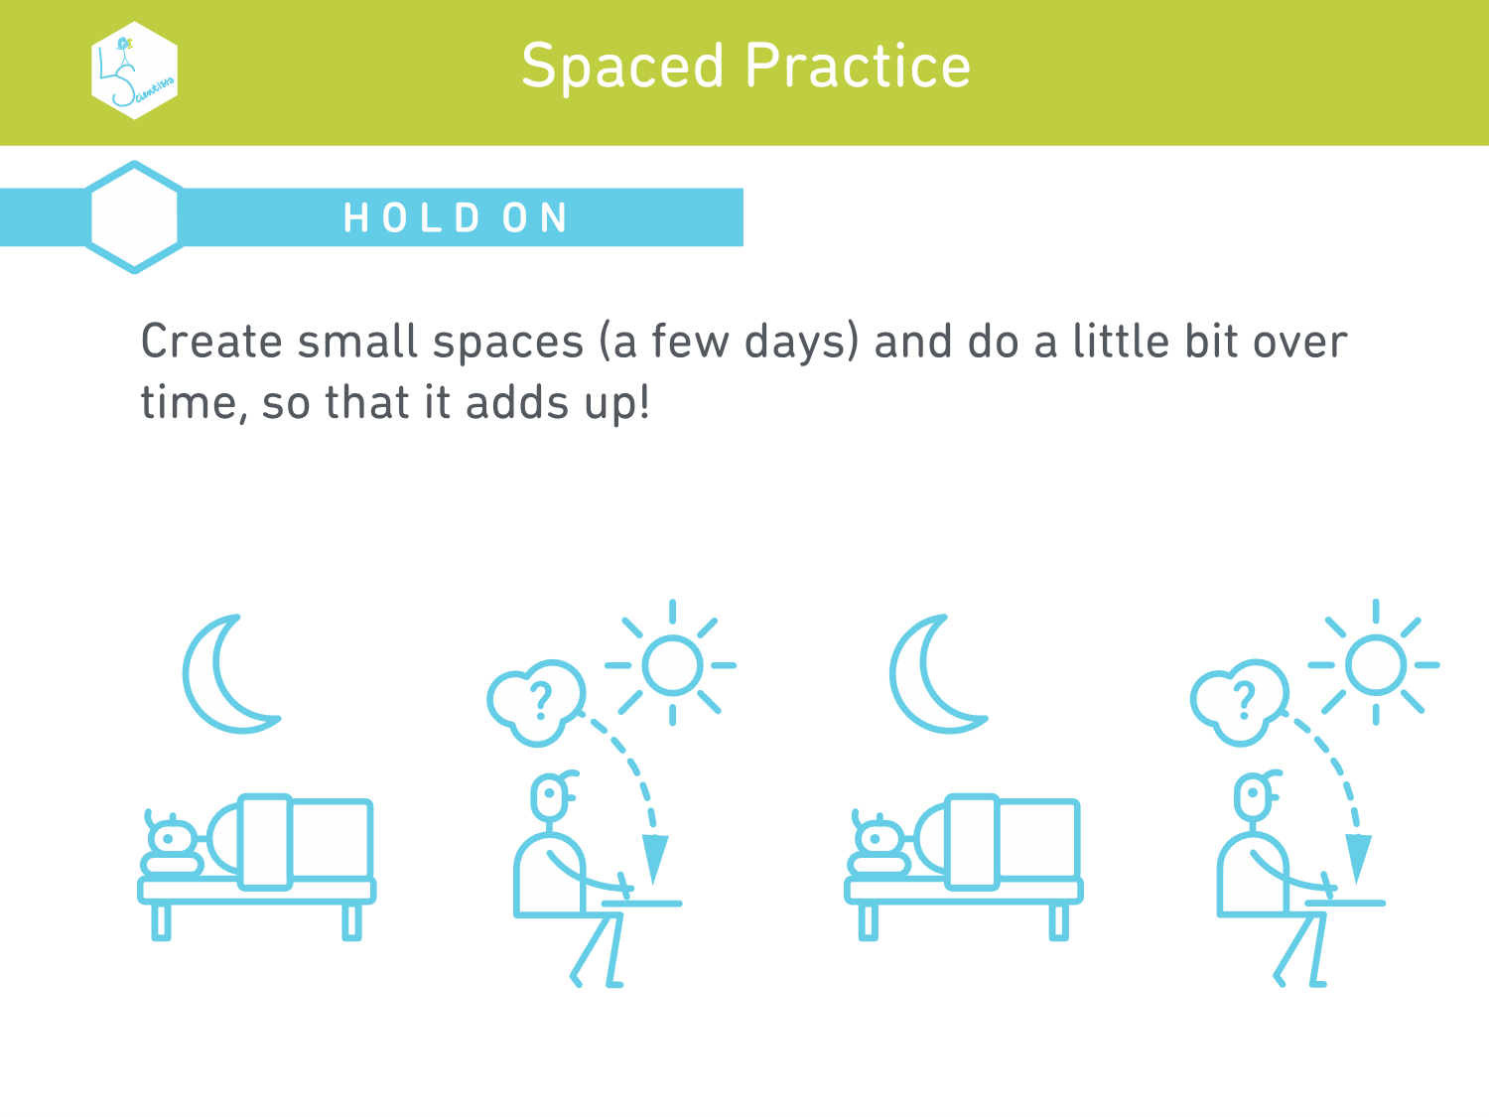

Slide 14
retrieval Practice

Slide 15
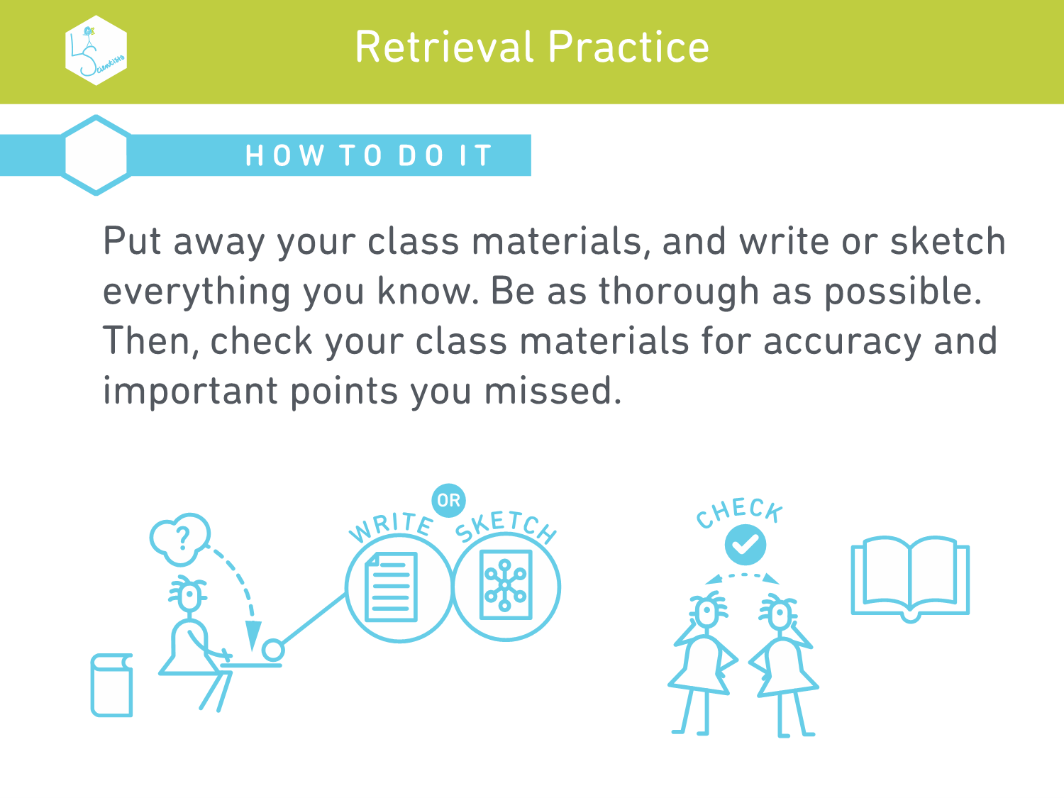
15

Slide 16
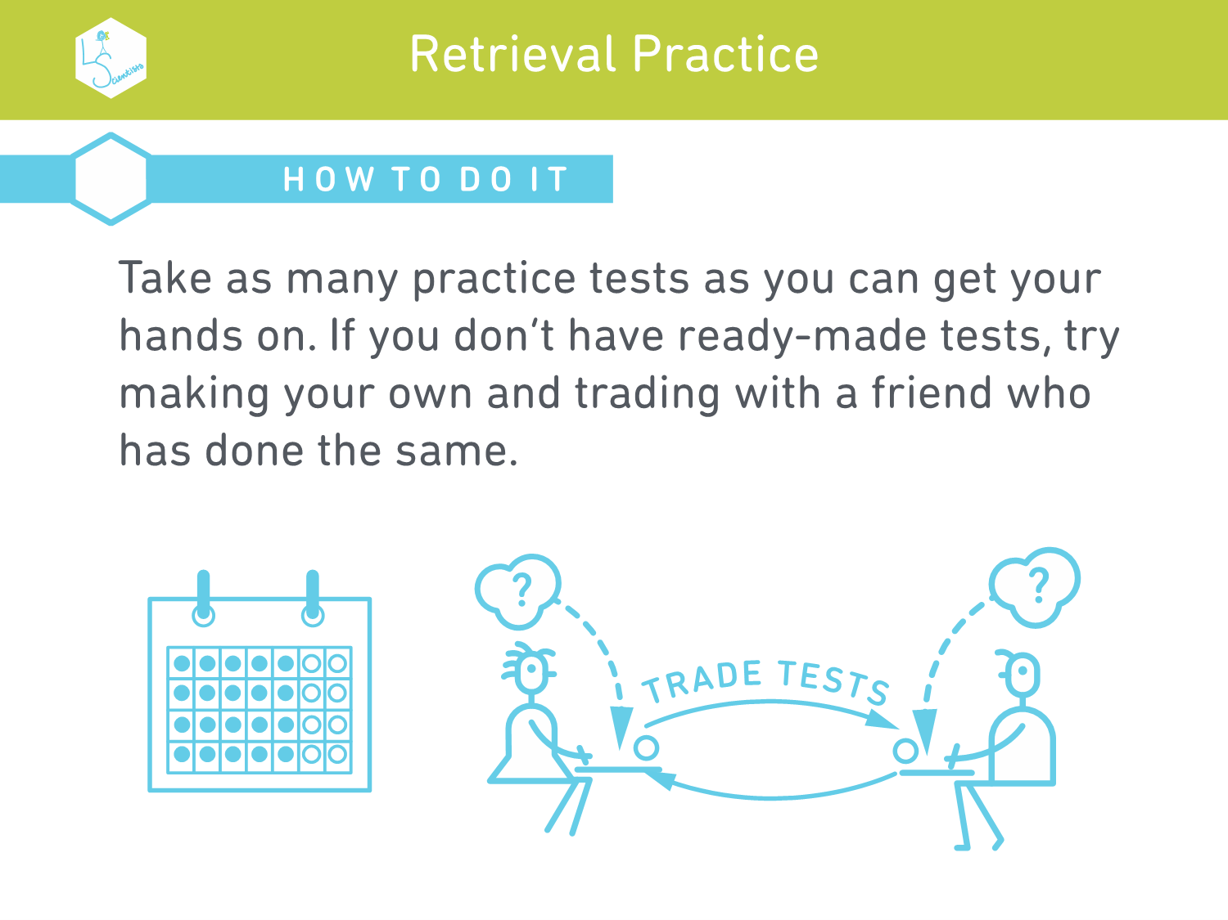

Slide 21
elaboration

Slide 22
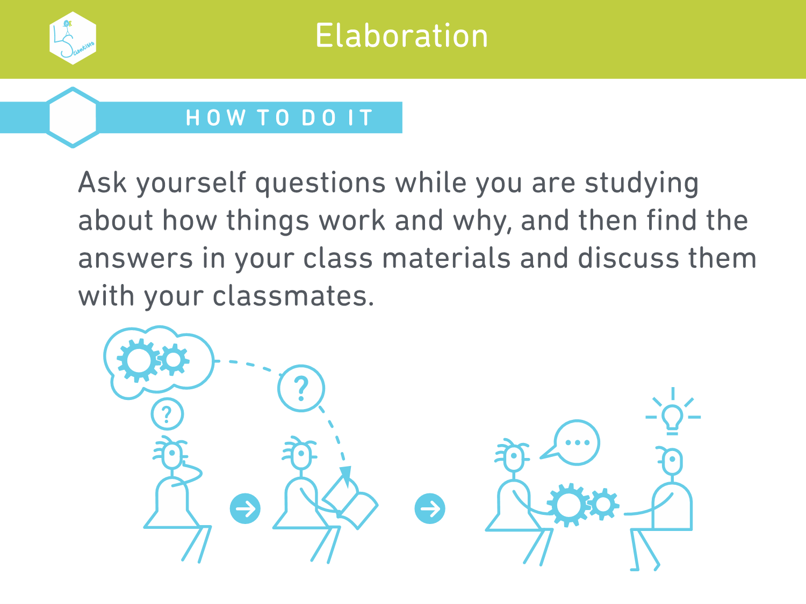
22

Slide 23
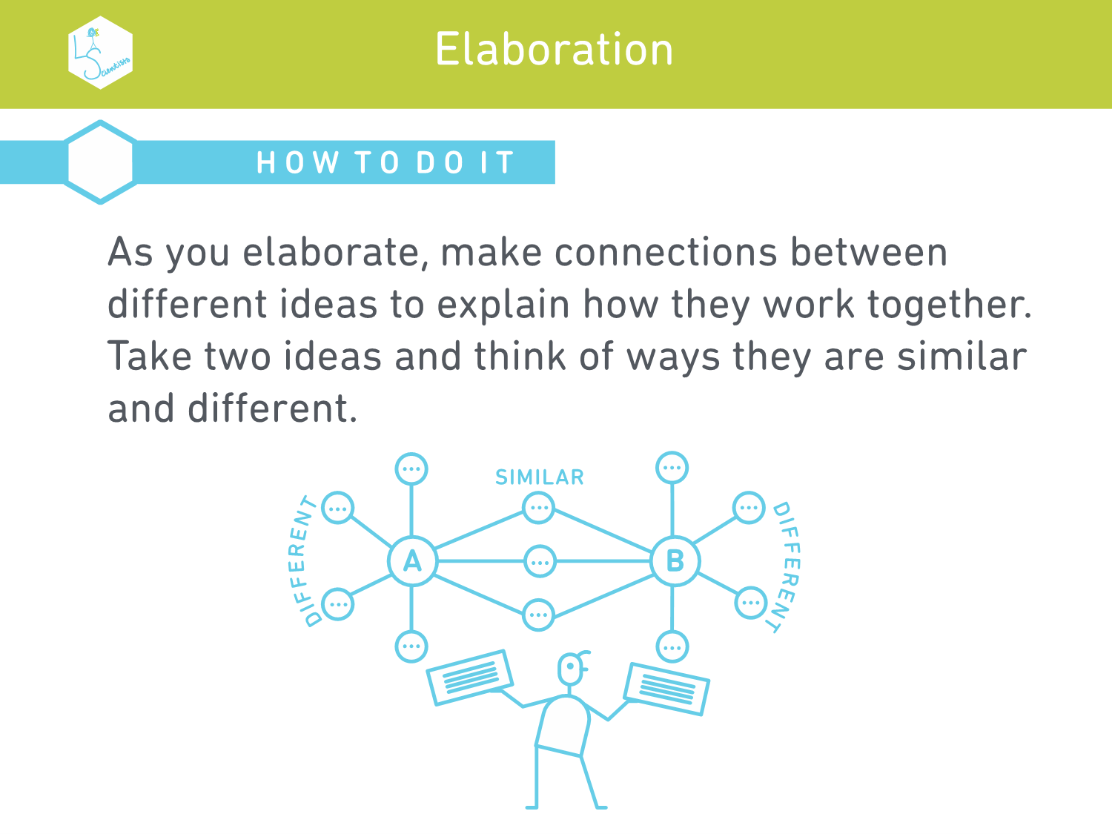

Slide 24
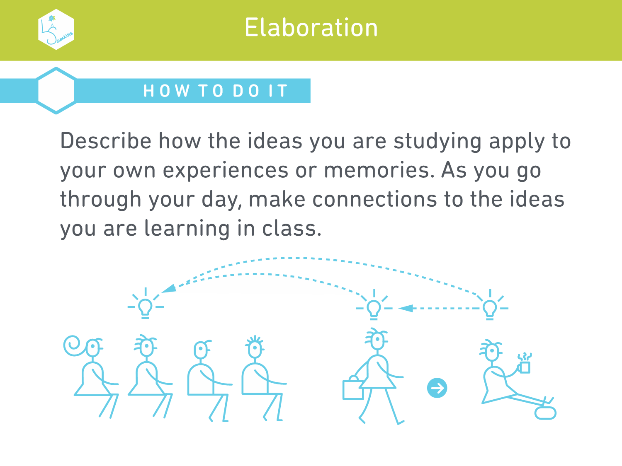

Slide 25
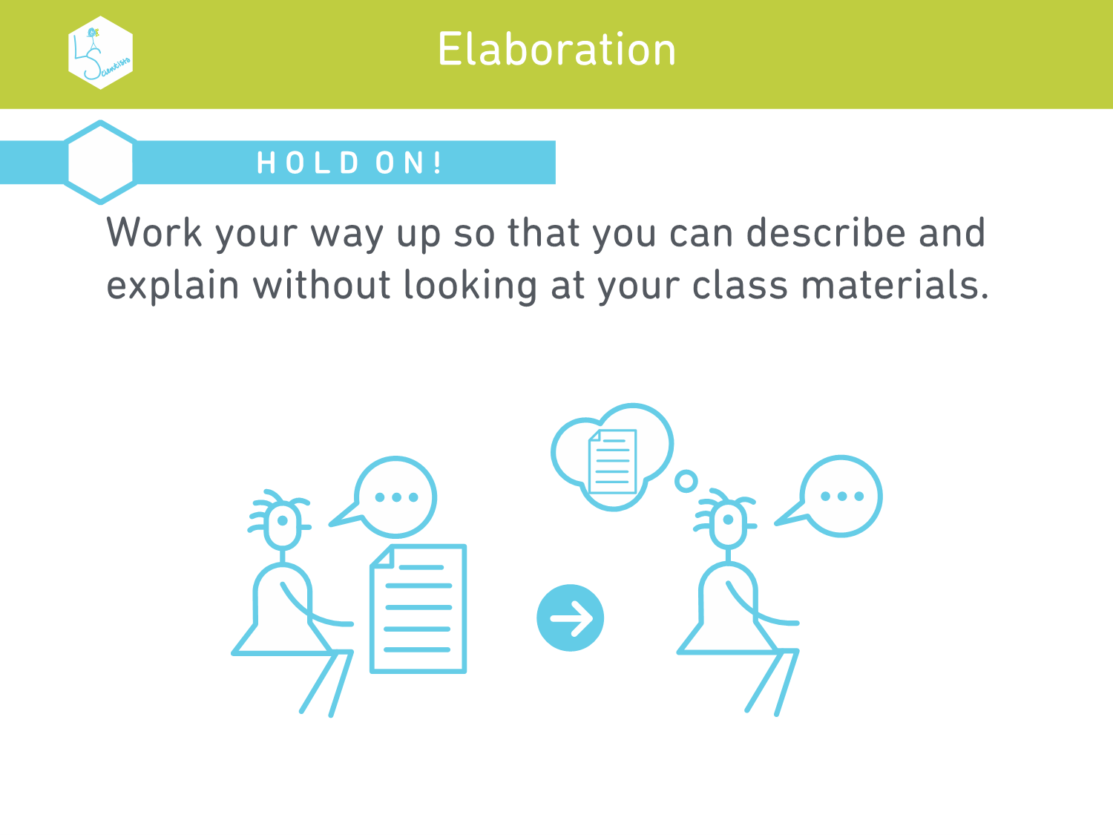

Slide 26
interleaving

Slide 28
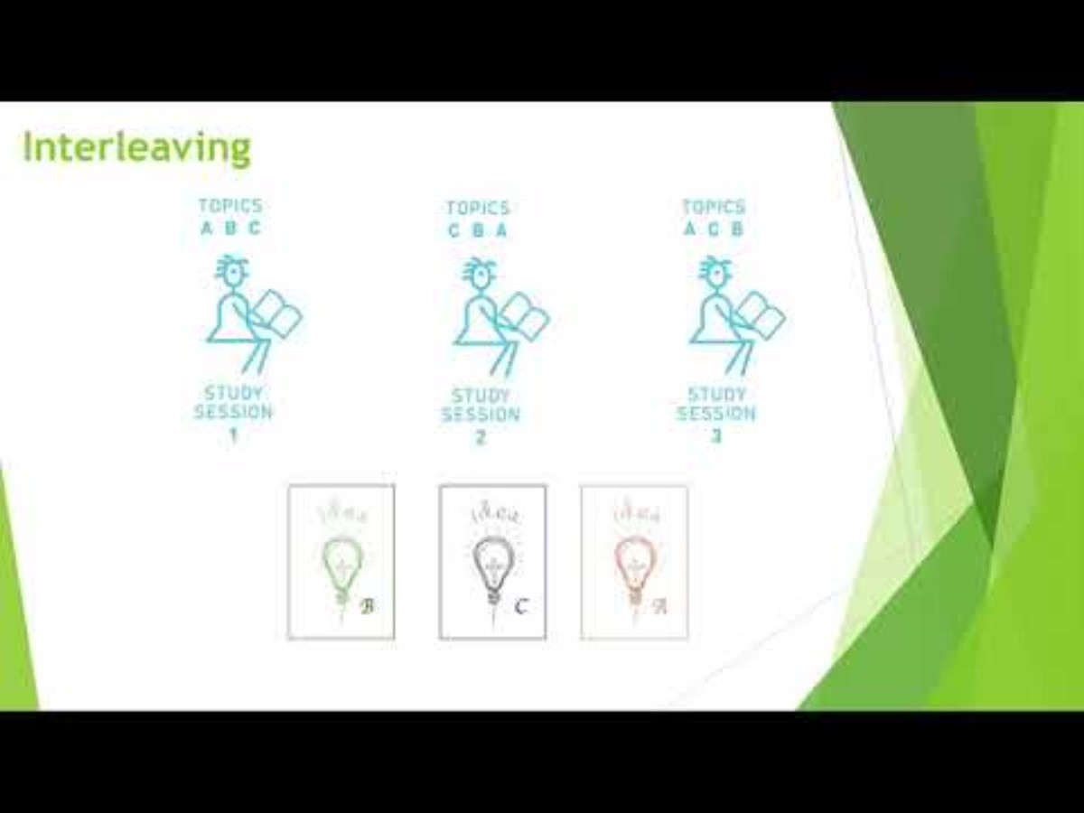

Slide 29
COncrete examples

Slide 30
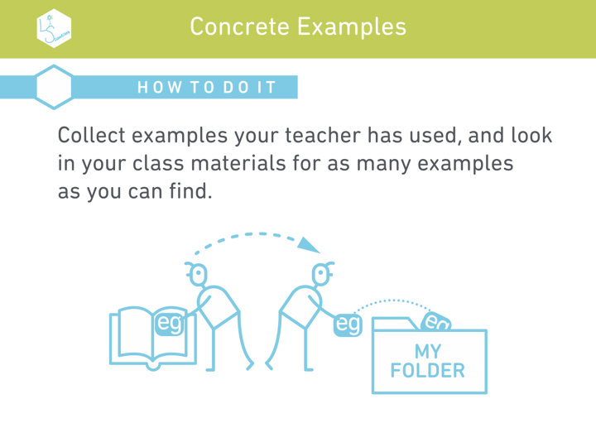
30

Slide 31
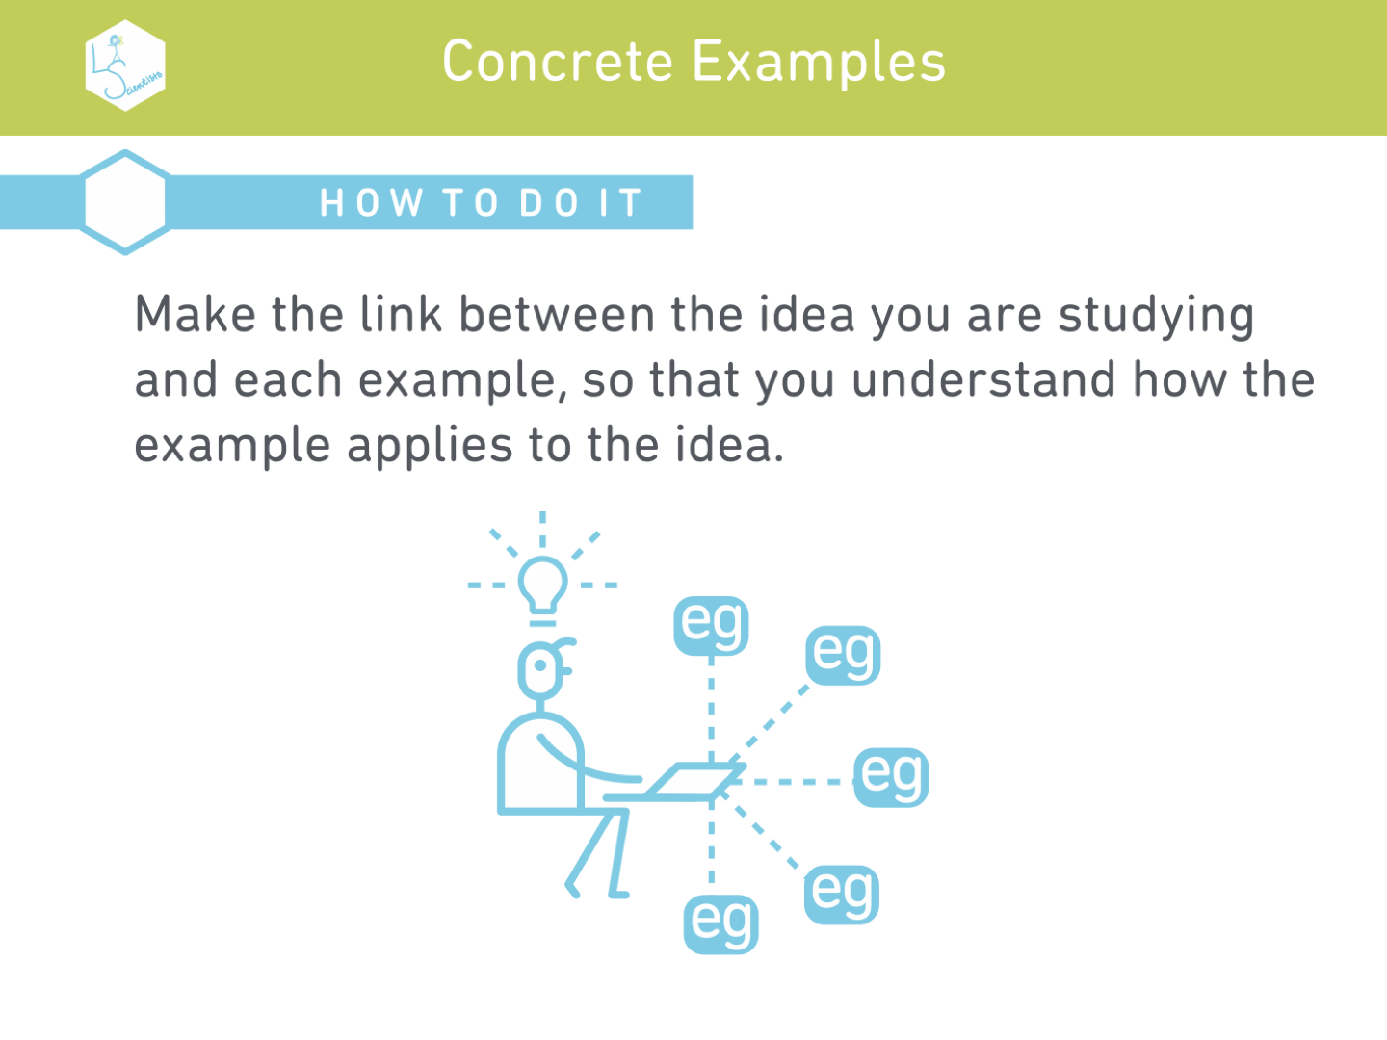

Slide 32
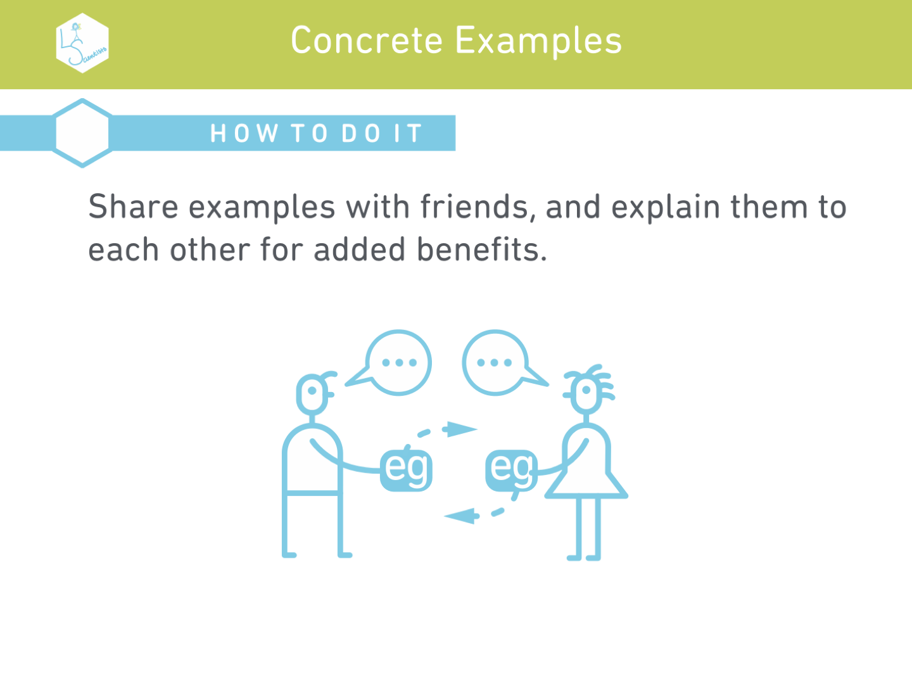

Slide 33
Dual coding

Slide 34
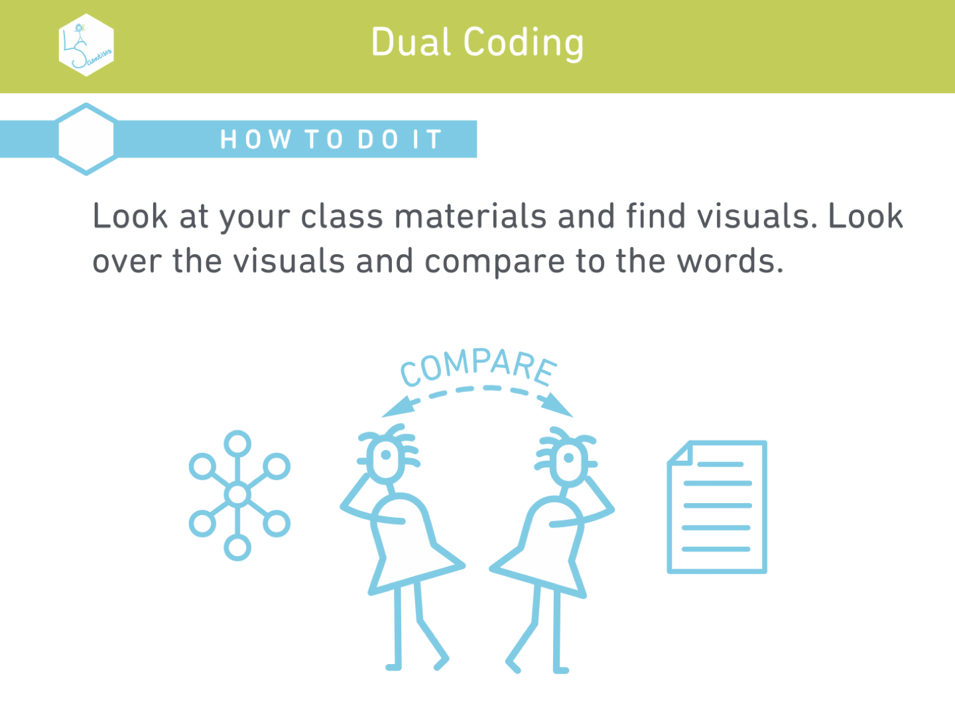

Slide 35
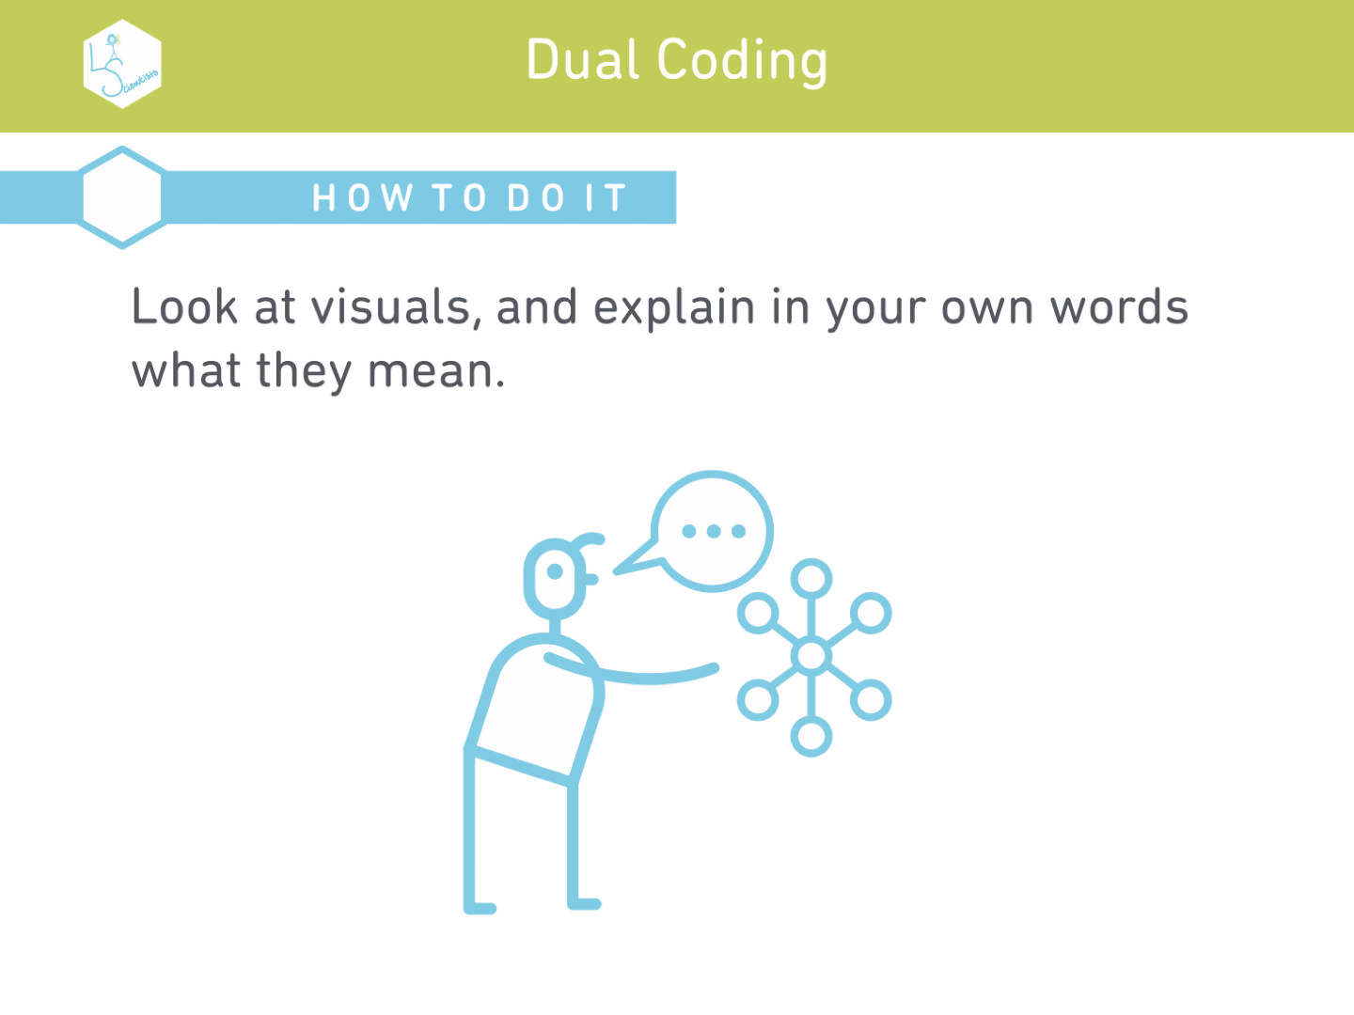

Slide 36
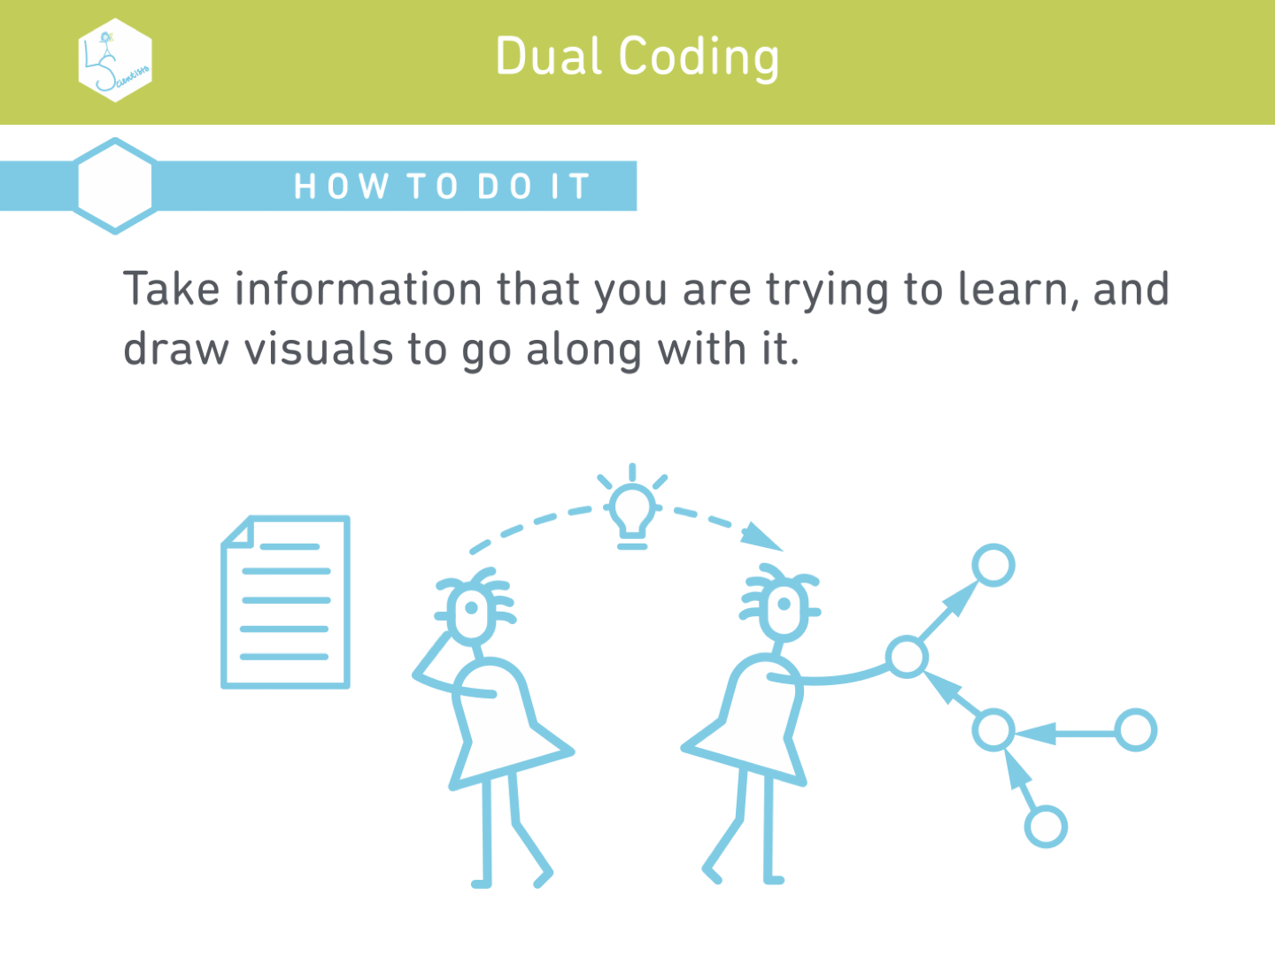

Slide 37


Slide 38
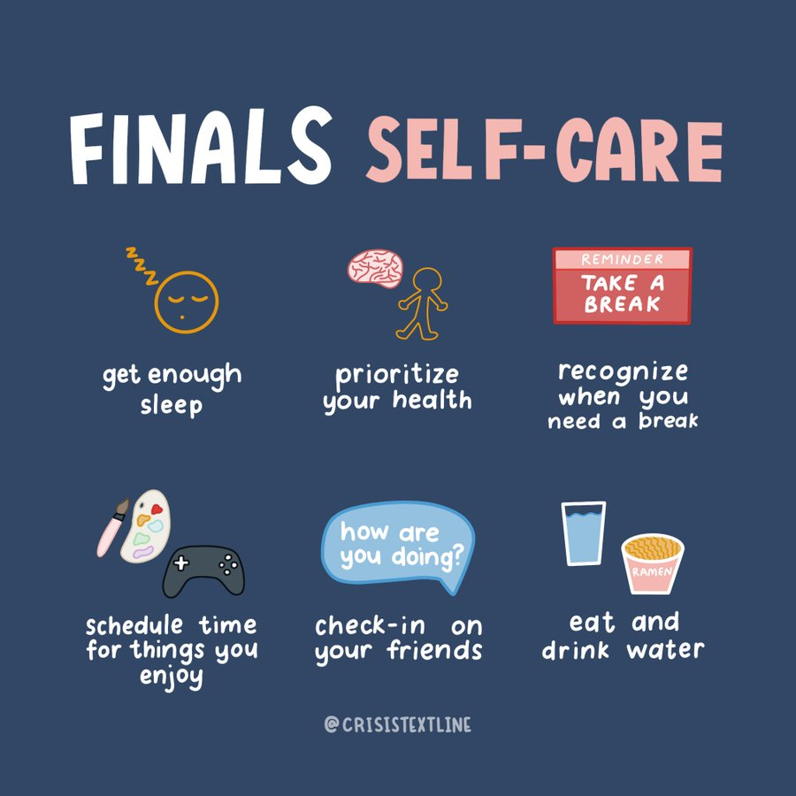
38

Slide 39


Slide 40
References
"The Body Double." ADD.org, Attention Deficit Disorder Association, add.org/the-body-double/. Accessed 23 May 2024.
"How to Create a Study Ritual." Launchpad, Charles Darwin University, www.cdu.edu.au/launchpad/student-life/how-create-study-ritual. Accessed 23 May 2024.
The Learning Scientists. www.learningscientists.org/. Accessed 23 May 2024.
"Using PATS." Learning Toolbox, James Madison University, coe.jmu.edu/learningtoolbox/pats.html. Accessed 23 May 2024.

